Slide 1
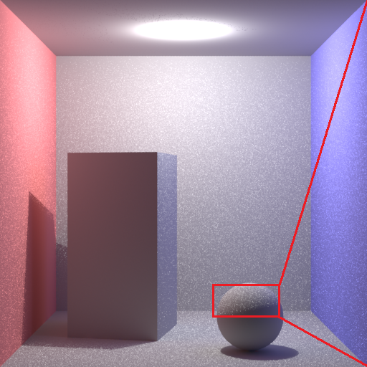

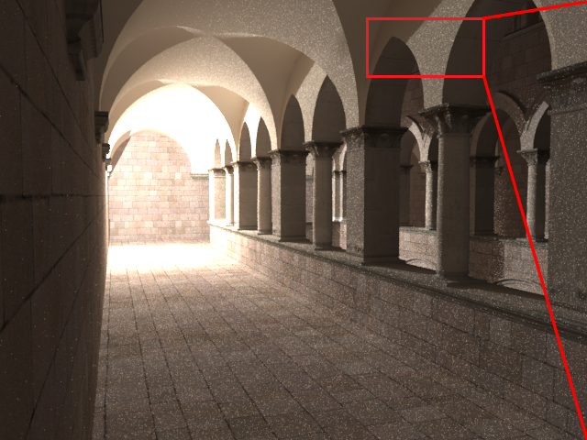





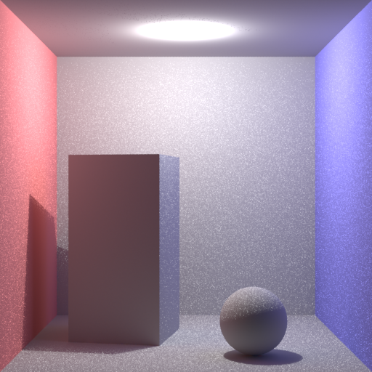
Final Gathering using Adaptive Multiple Importance Sampling
Yusuke Tokuyoshi
Square Enix Co.,Ltd.
Shinji Ogaki
Square Enix Co.,Ltd.
Sebastian Schoellhammer
Square Enix Co.,Ltd.
Figure 1: Upper: classic final gathering. Lower: our method. The same number of samples is used for both images (512 × 512 pixels, 4 oversamples, 1024 final gather rays/pixel). The number of iterations for AMIS is 4. The rendering times for upper and lower images are 116.5 seconds and 134.5 seconds, respectively.
Figure 2: Upper: classic final gathering. Bottom: our method. The same number of samples is used for both images (640×480 pixels, 4 oversamples, 1024 final gather rays/pixel). The number of iterations for AMIS is 4. The rendering times for upper and lower images are 185.5 seconds and 206.6 seconds, respectively. Model source: Sponza Atrium by Marko Dabrovic.
1. Introduction
(2)
Maximum likelihood estimation (MLE) is an appropriate method to update θ. The parameter α_{t+1} is estimated by MLE as
We propose an efficient final gathering technique using adaptive multiple importance sampling (AMIS) [Cornuet et al. 2009] for scenes with a highly intense spot of light. The performance of AMIS depends on a sampling strategy, i.e. the choice of a PDF. This poster suggests a suitable PDF for final gathering. Our method increases error in some cases, however, improves image quality if a scene has a highly bright spot of light compared to the classic method.
and the integral is estimated as
(3)
(5)
initialize PDF
However, obtaining n_{t+1} with MLE is computationally expensive. Therefore, we assume n_{t+1} to be the average of the sampled directions, which is given as
sample
highly intense spot of light
recompute weighting functions
(6)
update PDF
Figure 4: AMIS pipeline.
Note that PDFs for glossy reflection can be operated in the same manner. For example, if a reflectance model includes the phong distribution function [Lafortune and Willems 1994], we can replace the ray direction with the halfway vector in Equations (4)(5)(6), and the α₀ with the phong exponent of the reflectance model.
3. Method
The performance of AMIS depends on an updating scheme. In this section we propose an appropriate method for final gathering. Normally, final gather rays are generated according to the PDF of a reflectance model. If it is diffuse, the PDF of the lambertian model: p(ω) = (ω ・ n_{s})/π is often used (ω : ray direction, n_{s} : surface normal). We extend the PDF p with the parameter θ_{t} = (n_{t}, α_{t}) as
Figure 3: The sampling strategy of classic final gathering is using only reflectance model. It fails in the case of a scene contains a highly intense spot of light.
The computation order of our method is O(TM), where T is the number of iterations, and M the total number of samples. To reduce the computation time, we are bound to use a small number of iterations. It is more efficient to use only recent samples instead of all samples generated in the past.
2. Adaptive Multiple
Importance Sampling
(4)
The initial values of n₀ and α₀ are n_{s} and 1, respectively. Hence, Equation (4) is equivalent to the lambertian model at the beginning. However, it approximates the integrand as t increases. Therefore, our method is expected to generate less variance than the lambertian model.
4. Result
AMIS is aimed at optimally recycling past simulations in an iterative importance sampling scheme. The difference to earlier adaptive importance sampling methods is that the past weighting functions are recomputed by multiple importance sampling [Veach 1997] at each iteration. After t iterations, the weighting function w_{j}(ω) (0 ≤ j ≤ t) is given as
Figure 1 and Figure 2 show the experimental results. Our method reduces noise compared to the classic method with small overhead.
References
(1)
CORNUET, J.-M., MARIN, J.-M., MIRA, A., AND ROBERT, C. 2009.
Adaptive multiple importance sampling. Tech. rep., arXiv:0907.1254.
LAFORTUNE, E. P., AND WILLEMS, Y. D. 1994. Using the modified
phong reflectance model for physically based rendering. Tech. rep.,
Report CW197, Department of Computer Science, K.U.Leuven.
VEACH, E. 1997. Robust Monte Carlo Methods for Light Transport
Simulation. PhD thesis, Stanford University.
where p is the PDF at the jth iteration. The parameter θ_{j} is updated by using past samples. This procedure will be described in the next section. Let f(ω) be the integrand, the weighted value of the ith sample at the jth iteration is obtained as
first iteration
next iteration
Figure 5: Our PDF is optimized to incident radiance distribution in an iterative fashion.

